Slide 1

Natural Language Processing DLO 8012
Subject In-charge
Ms Vincy Joseph
Assistant Professor
email: vincyjoseph@sfit.ac.in

Slide 2
Module V
Lecture 29 Discourse Integration

Slide 3
Preferences in Pronoun Interpretation
Here we look into different methodologies used for pronoun resolution

Slide 4
1. Recency
Most theories assumes that entities introduced in recent utterances are more salient than those utterances further back.
E.g.
John has an Integra. Bill has a Legend. Mary likes to drive it.
(Here it is presumed that Mary likes to drive Legend)

Slide 5
2. Grammatical Role
Some theories specify a salience hierarchy of entities ordered by the grammatical position of the expressions.
It treat entities mentioned in subject position as more salient than those in object position, which are in turn more salient than subsequent positions.

Slide 6
2. Grammatical Role
E.g.
John went to the Acura dealership with Bill. He bought an Integra. [ he = John ]
Bill went to the Acura dealership with John. He bought an Integra. [ he = Bill ]
John and Bill went to the Acura dealership. He bought an Integra. [ he = ?? ].

Slide 7
Repeated Mention
Some theories incorporate the idea that entities that have been focused on in the prior discourse are more likely to continue to be focused on in subsequent discourse
E.g.
John needed a car to get to his new job. He decided that he wanted something sporty. Bill went to the Acura dealership with him. He bought an Integra. [ he = John]

Slide 8
Parallelism
There are also strong preferences that appear to be induced by parallelism effects.
E.g.
Mary went with Sue to the Acura dealership. Sally went with her to the Mazda dealership. [ her = Sue ]

Slide 9
Heuristics
This suggests that we might want a heuristic which says that non-subject pronouns prefer non-subject referents.
Consider the following example in which Mary is the preferred referent of the pronoun instead of Sue.
E.g.
Mary went with Sue to the Acura dealership. Sally told her not to buy anything. [ her = Mary ]

Slide 10
Verb Semantics
Certain verbs appear to place a semantically-oriented emphasis on one of their argument positions based on the manner in which subsequent pronouns are interpreted.
Based on Subject:
E.g. John telephoned Bill. He lost the pamphlet on Acura.[He = John]
John criticized Bill. He lost the pamphlet on Acura. [He = Bill]

Slide 11
Verb Semantics
Based on Goal Thematic Role:
E.g.
John seized the Acura pamphlet from Bill. He loves reading about cars. (Goal=John, Source=Bill)
John passed the Acura pamphlet to Bill. He loves reading about cars. (Goal=Bill, Source=John)

Slide 12
Verb Semantics
Based on Stimulus Experiencer Role:
E.g.
The car dealer admired John. He knows Acuras inside and out. (Stimulus=John, Experiencer=the car dealer)
The car dealer impressed John. He knows Acuras inside and out. (Stimulus=the car dealer, Experiencer=John)

Slide 13
Lappin and Leass Algorithm for Pronoun Resolution

Slide 14
Revision of English Grammar

Slide 15
Subject
The pronoun, noun or noun phrase that does the action of the verb
Subject is usually before the verb
E.g.
John Arrived.
I love chocolate
It can also be a group of words
E.g.
An orange cat was sitting beside me

Slide 16
Subject
Some verbs are not actions but linking verbs that links to more information about the subject
Linking Verbs : be, seem, become
E.g.
I am hungry
John seemed tired
Subjects can be long
E.g.
The man who lives upstairs lied

Slide 17
Subject
Subjects can include 2 or more nouns
E.g.
Lucy’s grey cat and John’s white cat are friends

Slide 18
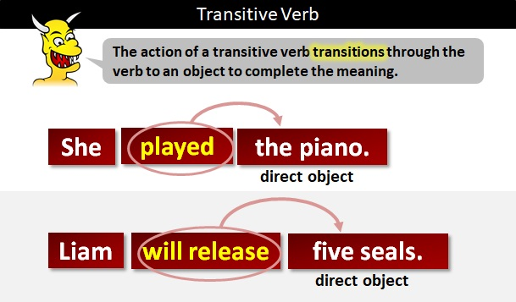
Object
It is a thing or person that the verb is done to or who receives verb
It can be a noun, noun phrase, pronoun or a longer complex object
Only transitive verb can have object

Slide 19
Object
E.g.
I love chocolate
David met Lucy yesterday
I put the orange cat into the garden

Slide 20
Direct Object
It is the thing or person to whom or to which we do the action verb
E.g.
I give the chocolate
David met Mary yesterday

Slide 21
Indirect Object
It is the person who receives the direct object
E.g.
I made my friend (IO) some coffee (DO)
I threw John (IO) the ball (DO)

Slide 22
Lappin and Leass Algorithm
It employs a simple weighting scheme that integrates the effects of the recency and syntactically-based preferences
It employs no semantic preferences
There are two types of operations performed by the algorithm:
discourse model update
pronoun resolution.

Slide 23
Lappin and Leass Algorithm
When a noun phrase that evokes a new entity is encountered, a representation for it must be added to the discourse model and a degree of salience computed for it.
The salience value is calculated as the sum of the weights assigned by a set of salience factors.

Slide 24
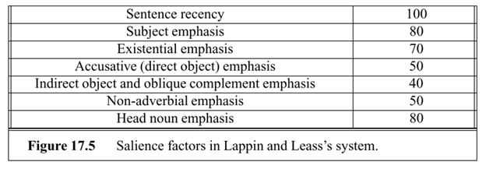
Lappin and Leass Algorithm
The salience factors used and their corresponding weights are

Slide 25
Subject Emphasis
That means the focus is usually on the subject and what the subject does.

Slide 26
Existential Emphasis
It asserts the existence or non-existence of something
English relies on constructions introduced by There
The verb most often used in existential sentences is a form of be. Other verbs (e.g., exist, occur) may follow the existential there.
E.g.
There is always some madness in love
There are many exit visas sold in this café

Slide 27
Accusative (Direct Object) Emphasis
It shows the relationship of a direct object to a verb.
E.g.
We cooked our dinner.
Verb: cooked
Direct object: dinner

Slide 28
Indirect Object Emphasis
The emphasis is on the Indirect Object
E.g.
I made my friend (IO) who came from US some coffee (DO)

Slide 29
Oblique Complement Emphasis
It is prepositional phrase which behaves like a complement
E.g.
Pat will wait for Kim

Slide 30
Adverbial Emphasis
It is a term used for an intensifier used to give added force or a greater degree of certainty to another word in a sentence or a sentence as whole
Adverbs of emphasis are called emphasizers
E.g. absolutely, certainly,clearly,definitely
E.g.
He is tapping my phone and I definitely heard it

Slide 31
Head Noun Emphasis
It is the head of the noun that determines what sort of thing or person the whole noun phrase refers to
E.g.
All the cakes on the table tastes nice
Cakes taste nice

Slide 32
Lappin and Leass Algorithm
The weights that each factor assigns to an entity in the discourse model are cut in half each time a new sentence is processed.
E.g.
An Acura Integra is parked in the lot. (subject)
There is an Acura Integra parked in the lot. (existential predicate
nominal)
John parked an Acura Integra in the lot. (object)
John gave his Acura Integra a bath. (indirect object)

Slide 33
Lappin and Leass Algorithm
The weight for any referent is always positive.
The head noun emphasis factor penalizes referents which are embedded in larger noun phrases.
Once we have updated the discourse model with new potential referents and recalculated the salience values associated with them, we are ready to consider the process of resolving any pronouns that exist within a new sentence.

Slide 34
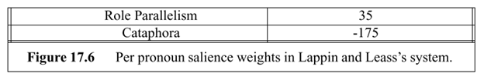
Lappin and Leass Algorithm
Two more salience weights, one for grammatical role parallelism between the pronoun and the potential referent, and one to disprefer cataphoric reference are considered here

Slide 35
Pronoun Resolution Algorithm
1. Collect the potential referents (up to four sentences back).
2. Remove potential referents that do not agree in number or gender with the pronoun.
3. Remove potential referents that do not pass intrasentential syntactic coreference constraints.

Slide 36
Pronoun Resolution Algorithm
4. Compute the total salience value of the referent by adding any applicable values to the existing salience value previously computed during the discourse model update step.
5. Select the referent with the highest salience value. In the case of ties, select the closest referent in terms of string position (computed without bias to direction).

Slide 37
Example
E.g. John saw a beautiful Acura Integra at the dealership. He showed it to Bob. He bought it.
First Sentence : John saw a beautiful Acura Integra at the dealership.
Second Sentence : He showed it to Bob.
Third Sentence : He bought it.

Slide 38
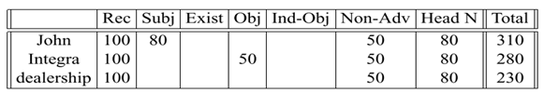
Resolution of First Sentence
First Sentence : John saw a beautiful Acura Integra at the dealership.
There are no pronouns to be resolved in this sentence, so we move on to the next, degrading the above values by a factor of two as shown in the table.

Slide 39
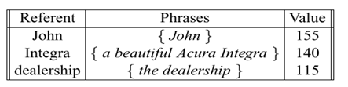
Second Sentence
Second Sentence : He showed it to Bob.
The ﬁrst noun phrase in second sentence is pronoun he.
Because he speciﬁes male gender, Step 2 of the resolution algorithm reduces the set of possible referents to include only John, so we can stop there and take this to be the referent.

Slide 40
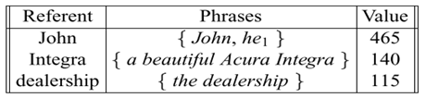
Second Sentence
Second Sentence : He showed it to Bob.
The pronoun is in the current sentence (recency=100), subject position (=80), not in an adverbial (=50), and head noun phrase (=80), and so a total of 310 is added to the current weight for John:

Slide 41
Second Sentence
Second Sentence : He showed it to Bob.
The next noun phrase in the second sentence is the pronoun it, which is compatible with the Integra or the dealership.
For the parallelism preference, both it and a beautiful Acura Integra are in object position within their respective sentences (whereas the dealership is not), so a weight of 35 is added to this option.

Slide 42
Second Sentence
Second Sentence : He showed it to Bob.
With the Integra having a weight of 175 (140+35) and the dealership a weight of 115, the Integra is taken to be the referent.
Discourse model is updated by adding 100(Recency) + 50(Object) + 50(not in an adverbial ) + 80 (Head Noun Phrase)=280 to the current weight for the Integra.

Slide 43

Second Sentence
Second Sentence : He showed it to Bob.
The ﬁnal noun phrase in the second sentence is Bob, which introduces a new discourse referent.
It receives a weight of 100(Recency) + 40(Indirect Object) + 50(not in an adverbial) + 80(Head Noun Phrase)=270.

Slide 44
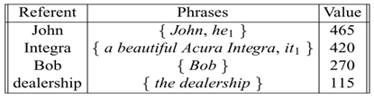
Second Sentence
Second Sentence : He showed it to Bob.
The ﬁnal weights of the second sentence is

Slide 45
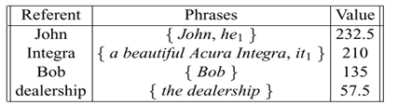
Third Sentence
Third Sentence : He bought it.
The ﬁrst noun phrase in third sentence is pronoun he.
Because he speciﬁes male gender, Step 2 of the resolution algorithm reduces the set of possible referents to John and Bob

Slide 46
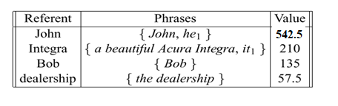
Third Sentence
Third Sentence : He bought it.
Since John is having more score, it is used to resolve he and updated weight of 310 (recency=100, subject position =80, not in an adverbial =50, and head noun phrase =80), is added to the current weight for John:

Slide 47
Third Sentence
Third Sentence : He bought it.
The next noun phrase in the second sentence is the pronoun it, which is compatible with the Integra or the dealership.
For the parallelism preference, both it and a beautiful Acura Integra are in object position within their respective sentences (whereas the dealership is not), so a weight of 35 is added to this option.

Slide 48
Third Sentence
Third Sentence : He bought it.
With the Integra having a weight of 245 (210+35) and the dealership a weight of 57.5, the Integra is taken to be the referent.
Discourse model is updated by adding 100(Recency) + 50(Object) + 50(not in an adverbial ) + 80 (Head Noun Phrase)=280 to the current weight for the Integra.

Slide 49
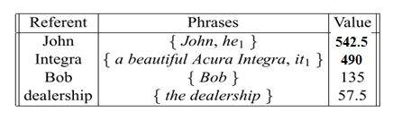
Updated Weights

Slide 50
End

